Slide 1
Chapter 6: File Management

Slide 2
Outline
File Concept
Access Methods
Disk and Directory Structure
Protection
Memory-Mapped Files

Slide 3
File Concept
Contiguous logical address space
Types:
Data
Numeric
Character
Binary
Program
Contents defined by file’s creator
Many types
text file,
source file,
executable file

Slide 4
File Attributes
Name – only information kept in human-readable form
Identifier – unique tag (number) identifies file within file system
Type – needed for systems that support different types
Location – pointer to file location on device
Size – current file size
Protection – controls who can do reading, writing, executing
Time, date, and user identification – data for protection, security, and usage monitoring
Information about files are kept in the directory structure, which is maintained on the disk
Many variations, including extended file attributes such as file checksum
Information kept in the directory structure

Slide 5
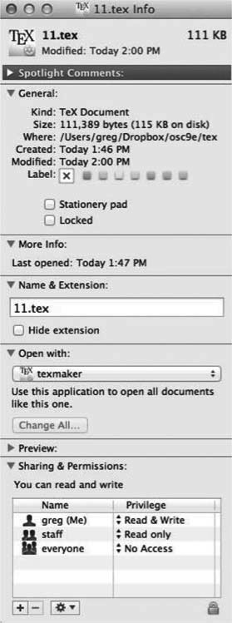
File info Window on Mac OS X (Self Study)

Slide 6
File Operations
Create
Write – at write pointer location
Read – at read pointer location
Reposition within file - seek
Delete
Truncate
Open (F_{i}) – search the directory structure on disk for entry F_{i}, and move the content of entry to memory
Close (F_{i}) – move the content of entry F_{i} in memory to directory structure on disk

Slide 7
Open Files (Self Study)
Several pieces of data are needed to manage open files:
Open-file table: tracks open files
File pointer: pointer to last read/write location, per process that has the file open
File-open count: counter of number of times a file is open – to allow removal of data from open-file table when last processes closes it
Disk location of the file: cache of data access information
Access rights: per-process access mode information

Slide 8
File Locking
Provided by some operating systems and file systems
Similar to reader-writer locks
Shared lock similar to reader lock – several processes can acquire concurrently
Exclusive lock similar to writer lock
Mediates access to a file
Mandatory or advisory:
Mandatory – access is denied depending on locks held and requested
Advisory – processes can find status of locks and decide what to do

Slide 9
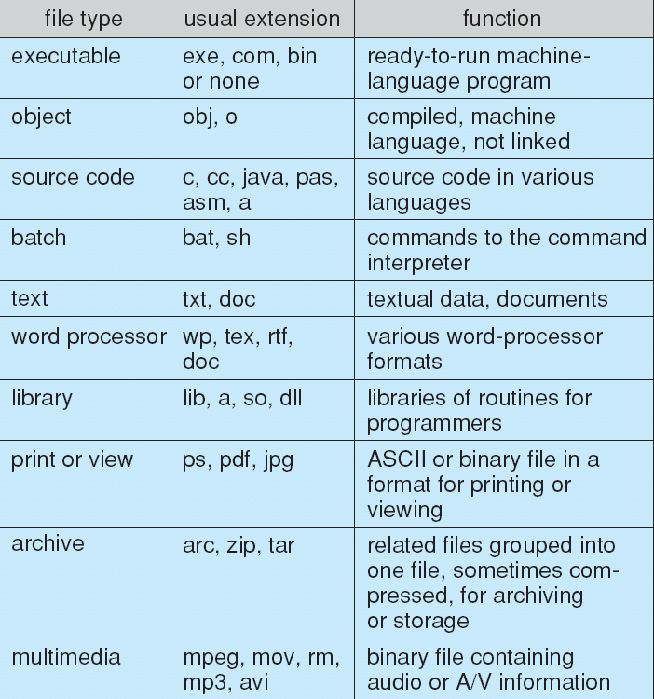
File Types – Name, Extension (Self Study)

Slide 10
File Structure
None - sequence of words, bytes
Simple record structure
Lines
Fixed length
Variable length
Complex Structures
Formatted document
Relocatable load file
Can simulate last two with first method by inserting appropriate control characters
Who decides:
Operating system
Program

Slide 11
Access Methods
A file is fixed length logical records
Sequential Access
Direct Access
Other Access Methods

Slide 12
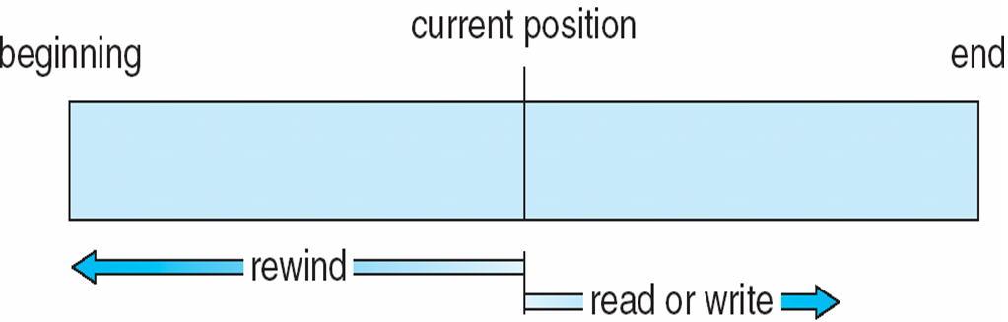
Sequential Access
Operations
read next
write next
Reset
no read after last write (rewrite)
Figure

Slide 13
Direct Access
Operations
read n
write n
position to n
read next
write next
rewrite n
n = relative block number
Relative block numbers allow OS to decide where file should be placed

Slide 14
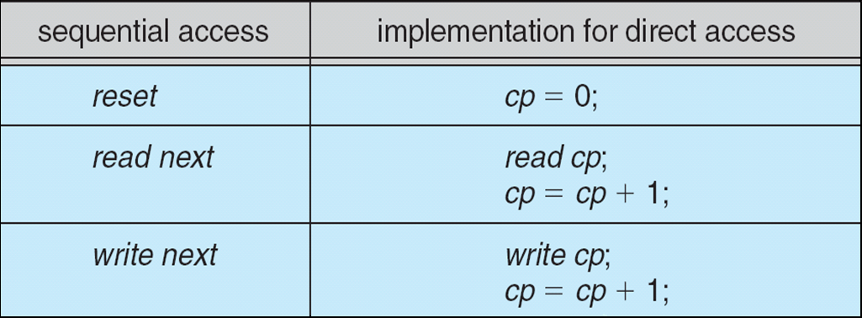
Simulation of Sequential Access on Direct-access File (Self Study)

Slide 15
Other Access Methods (Self Study)
Can be other access methods built on top of base methods
General involve creation of an index for the file
Keep index in memory for fast determination of location of data to be operated on (consider Universal Produce Code (UPC code) plus record of data about that item)
If the index is too large, create an in-memory index, which an index of a disk index
IBM indexed sequential-access method (ISAM)
Small master index, points to disk blocks of secondary index
File kept sorted on a defined key
All done by the OS
VMS operating system provides index and relative files as another example (see next slide)

Slide 16
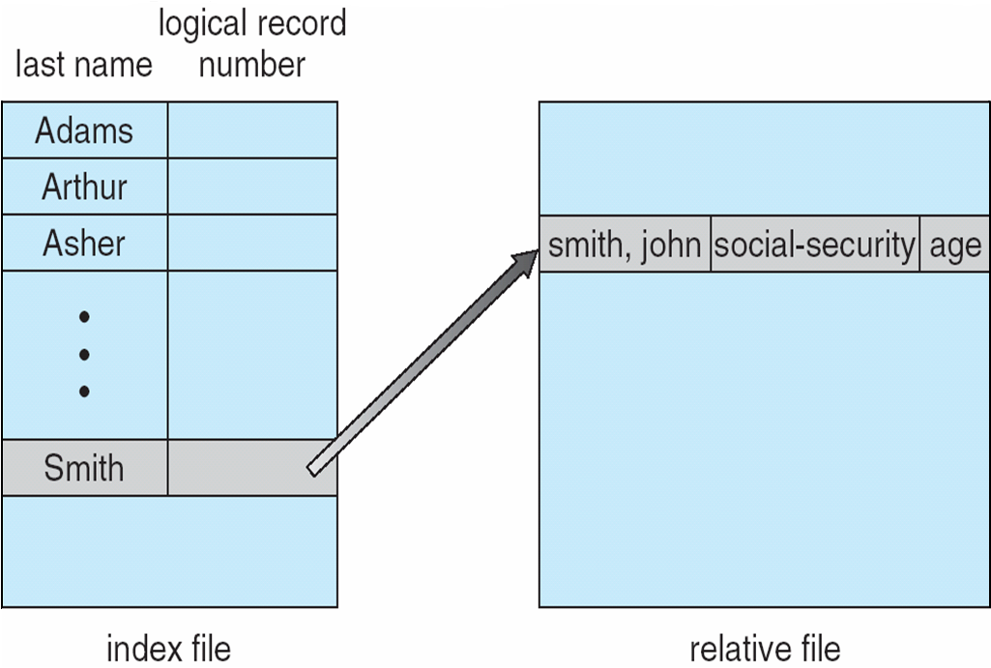
Example of Index and Relative Files (Self Study)

Slide 17
Disk Structure
Disk can be subdivided into partitions
Disks or partitions can be RAID protected against failure
Disk or partition can be used raw – without a file system, or formatted with a file system
Partitions also known as minidisks, slices
Entity containing file system is known as a volume
Each volume containing a file system also tracks that file system’s info in device directory or volume table of contents
In addition to general-purpose file systems there are many special-purpose file systems, frequently all within the same operating system or computer

Slide 18
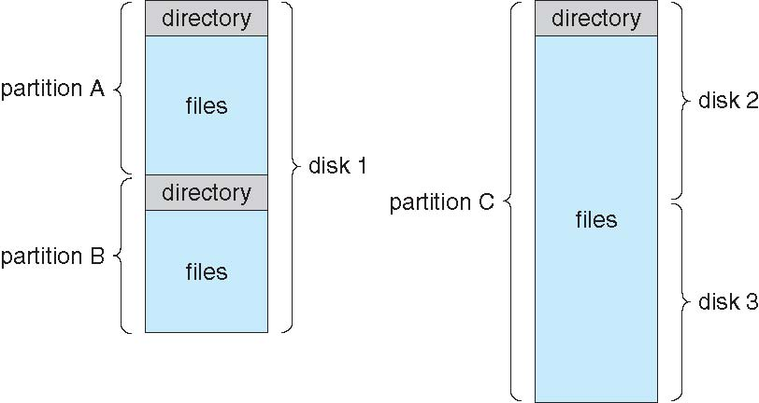
A Typical File-system Organization

Slide 19
Types of File Systems (Self Study)
We mostly talk of general-purpose file systems
But systems frequently have may file systems, some general- and some special- purpose
Consider Solaris has
tmpfs – memory-based volatile FS for fast, temporary I/O
objfs – interface into kernel memory to get kernel symbols for debugging
ctfs – contract file system for managing daemons
lofs – loopback file system allows one FS to be accessed in place of another
procfs – kernel interface to process structures
ufs, zfs – general purpose file systems

Slide 20
Directory Structure
A collection of nodes containing information about all files
Both the directory structure and the files reside on disk

Slide 21
Operations Performed on Directory
Search for a file
Create a file
Delete a file
List a directory
Rename a file
Traverse the file system

Slide 22
Directory Organization
The directory is organized logically to obtain
Efficiency – locating a file quickly
Naming – convenient to users
Two users can have same name for different files
The same file can have several different names
Grouping – logical grouping of files by properties, (e.g., all Java programs, all games, …)

Slide 23
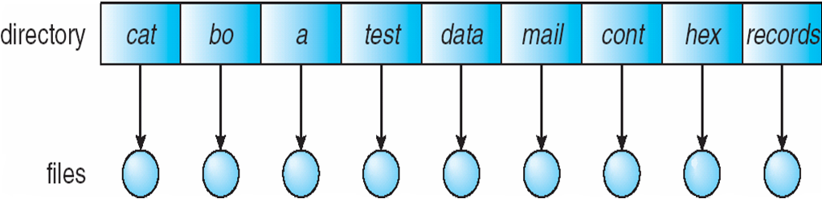
Single-Level Directory
A single directory for all users
Naming problem
Grouping problem

Slide 24
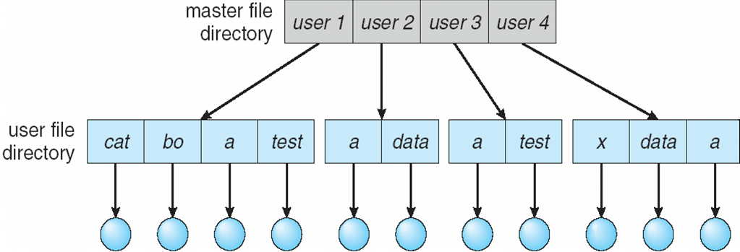
Two-Level Directory
Separate directory for each user
Path name
Can have the same file name for different user
Efficient searching
No grouping capability

Slide 25
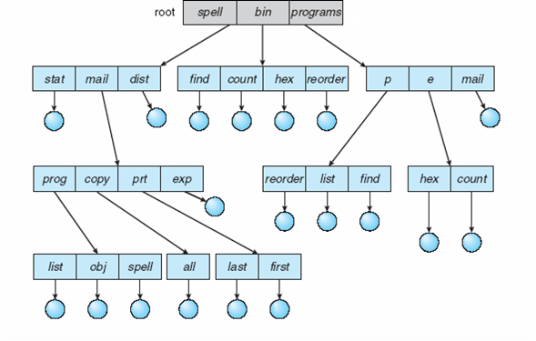
Tree-Structured Directories (Self Study)

Slide 26
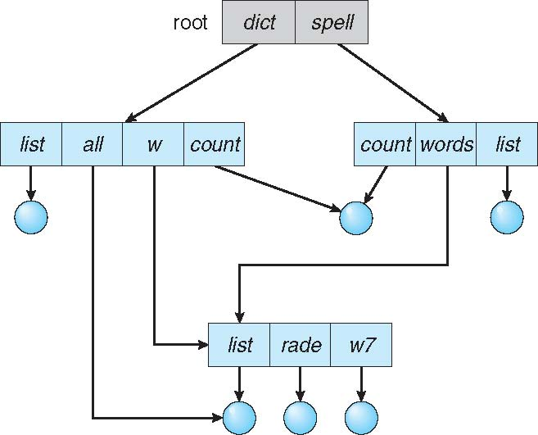
Acyclic-Graph Directories (Self Study)
Have shared subdirectories and files
Example

Slide 27
Acyclic-Graph Directories (Cont.) (Self Study)
Two different names (aliasing)
If dict deletes w/list ⇒ dangling pointer
Solutions:
Backpointers, so we can delete all pointers.
Variable size records a problem
Backpointers using a daisy chain organization
Entry-hold-count solution
New directory entry type
Link – another name (pointer) to an existing file
Resolve the link – follow pointer to locate the file

Slide 28
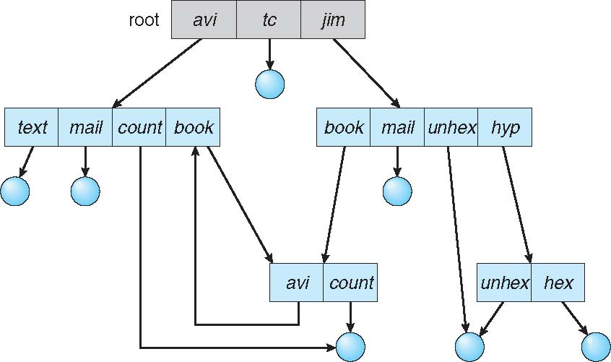
General Graph Directory (Self Study)

Slide 29
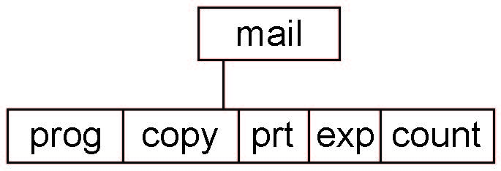
Current Directory
Can designate one of the directories as the current (working) directory
cd /spell/mail/prog
type list
Creating and deleting a file is done in current directory
Example of creating a new file
If in current directory is /mail
The command
mkdir <dir-name>
Results in:
Deleting “mail” ⇒ deleting the entire subtree rooted by “mail”

Slide 30
Protection
File owner/creator should be able to control:
What can be done
By whom
Types of access
Read
Write
Execute
Append
Delete
List

Slide 31
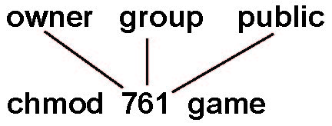
Access Lists and Groups in Unix (Self Study)
Mode of access: read, write, execute
Three classes of users on Unix / Linux
RWX
a) owner access 7 ⇒ 1 1 1 RWX
b) group access 6 ⇒ 1 1 0
RWX
c) public access 1 ⇒ 0 0 1
Ask manager to create a group (unique name), say G, and add some users to the group.
For a file (say game) or subdirectory, define an appropriate access.
Attach a group to a file
chgrp G game

Slide 32
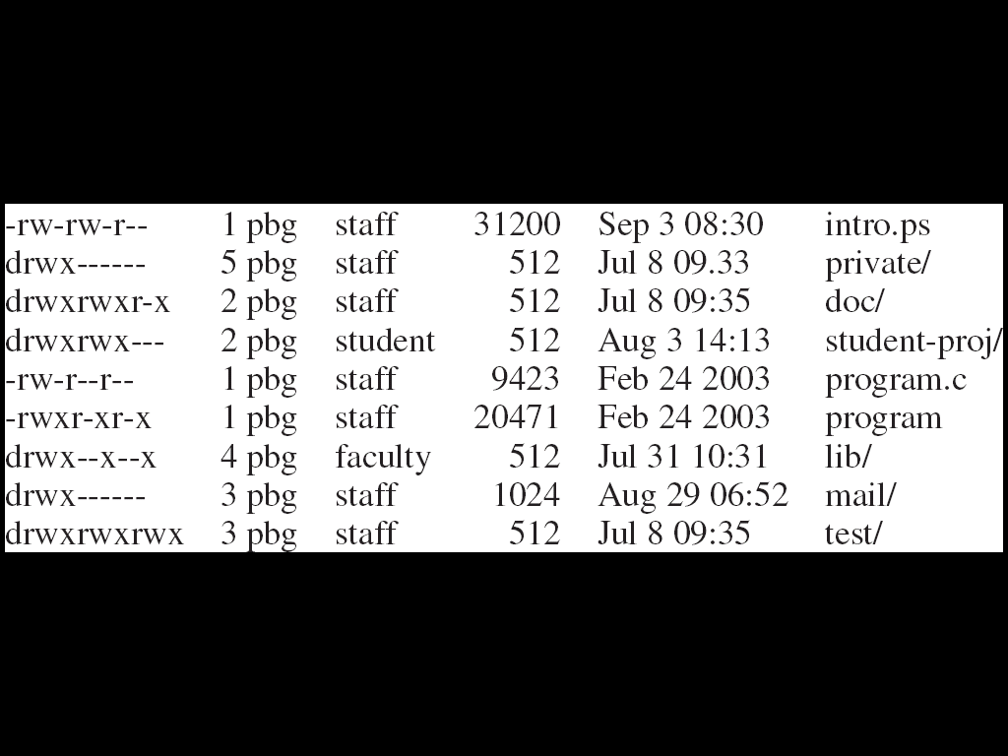
A Sample UNIX Directory Listing (Self Study)

Slide 33
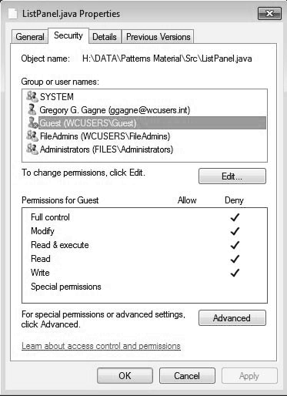
Windows 7 Access-Control List Management (Self Study)

Slide 34
Chapter 6 (Cont’d): File System Implementation

Slide 35
Outline
File-System Structure
File-System Operations
Allocation Methods

Slide 36
File-System Structure
File structure
Logical storage unit
Collection of related information
File system resides on secondary storage (disks)
Provided user interface to storage, mapping logical to physical
Provides efficient and convenient access to disk by allowing data to be stored, located retrieved easily
Disk provides in-place rewrite and random access
I/O transfers performed in blocks of sectors (usually 512 bytes)
File control block (FCB) – storage structure consisting of information about a file
Device driver controls the physical device
File system organized into layers

Slide 37
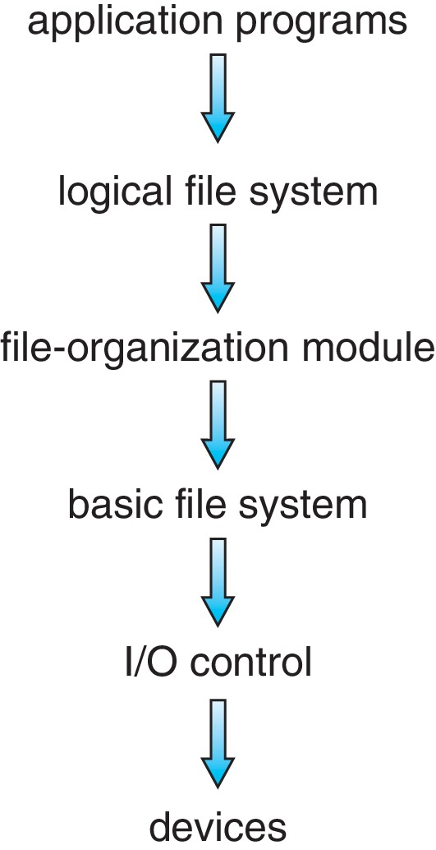
Layered File System

Slide 38
File System Layers
Device drivers manage I/O devices at the I/O control layer
Given commands like
read drive1, cylinder 72, track 2, sector 10, into memory location 1060
Outputs low-level hardware specific commands to hardware controller
Basic file system given command like “retrieve block 123” translates to device driver
Also manages memory buffers and caches (allocation, freeing, replacement)
Buffers hold data in transit
Caches hold frequently used data
File organization module understands files, logical address, and physical blocks
Translates logical block # to physical block #
Manages free space, disk allocation

Slide 39
File System Layers (Cont.)
Logical file system manages metadata information
Translates file name into file number, file handle, location by maintaining file control blocks (inodes in UNIX)
Directory management
Protection
Layering useful for reducing complexity and redundancy, but adds overhead and can decrease performance
Logical layers can be implemented by any coding method according to OS designer

Slide 40
File System Layers (Cont.) (Self Study)
Many file systems, sometimes many within an operating system
Each with its own format:
CD-ROM is ISO 9660;
Unix has UFS, FFS;
Windows has FAT, FAT32, NTFS as well as floppy, CD, DVD Blu-ray,
Linux has more than 130 types, with extended file system ext3 and ext4 leading; plus distributed file systems, etc.)
New ones still arriving – ZFS, GoogleFS, Oracle ASM, FUSE

Slide 41
File-System Operations (Self Study)
We have system calls at the API level, but how do we implement their functions?
On-disk and in-memory structures
Boot control block contains info needed by system to boot OS from that volume
Needed if volume contains OS, usually first block of volume
Volume control block (superblock, master file table) contains volume details
Total # of blocks, # of free blocks, block size, free block pointers or array
Directory structure organizes the files
Names and inode numbers, master file table

Slide 42
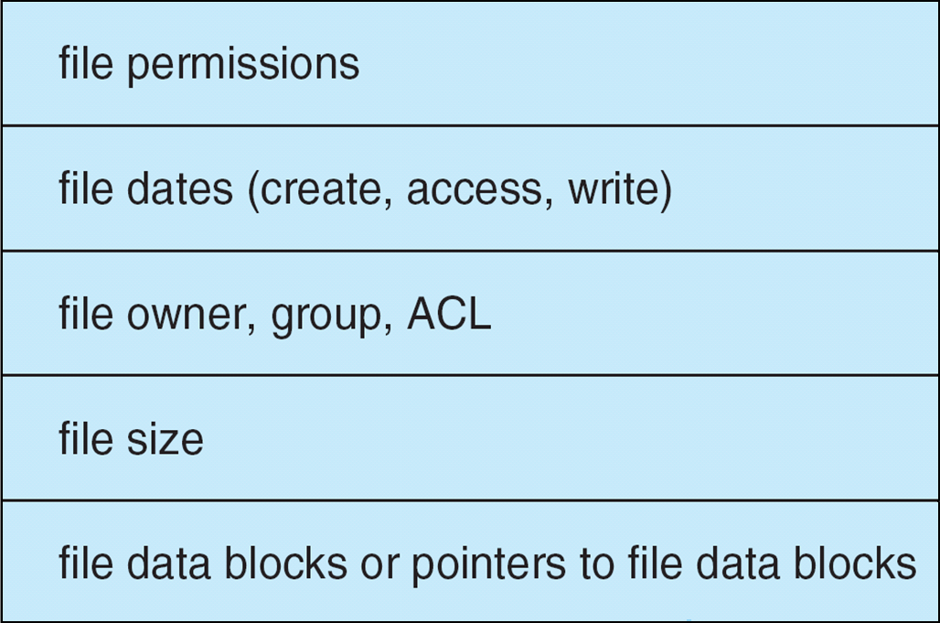
File Control Block (FCB) (Self Study)
OS maintains FCB per file, which contains many details about the file
Typically, inode number, permissions, size, dates
Example

Slide 43
Allocation Method
An allocation method refers to how disk blocks are allocated for files:
Contiguous
Linked
File Allocation Table (FAT)

Slide 44
Contiguous Allocation Method
An allocation method refers to how disk blocks are allocated for files:
Each file occupies set of contiguous blocks
Best performance in most cases
Simple – only starting location (block #) and length (number of blocks) are required
Problems include:
Finding space on the disk for a file,
Knowing file size,
External fragmentation, need for compaction off-line (downtime) or on-line

Slide 45
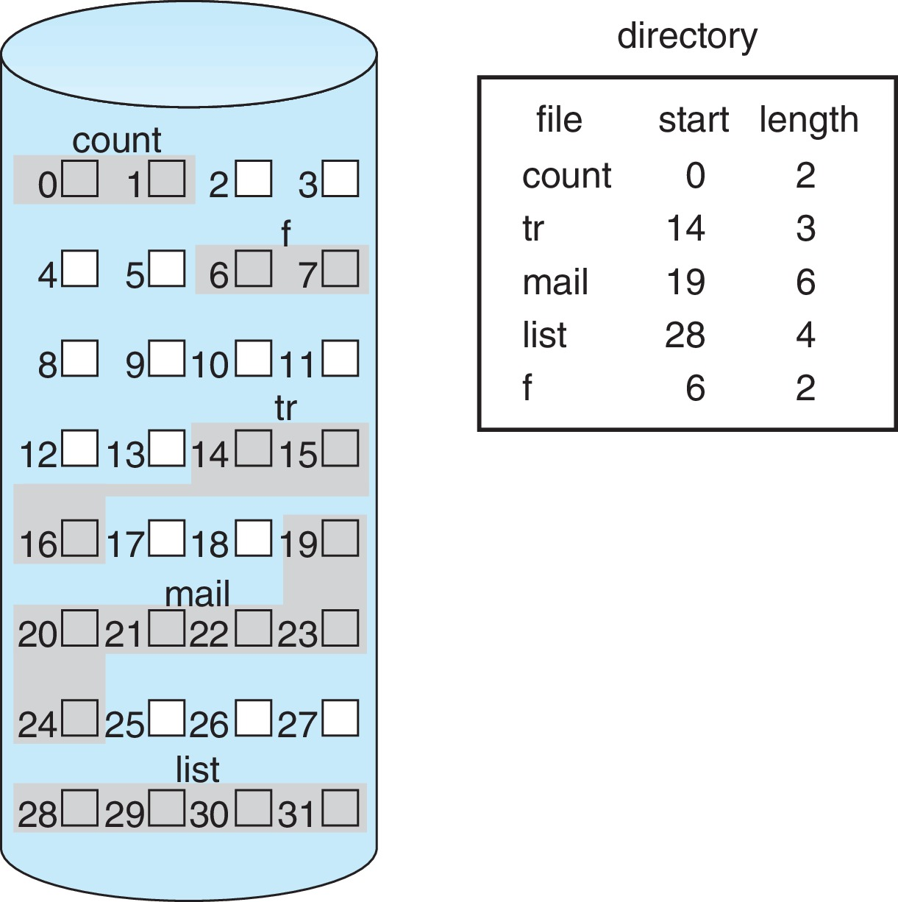
Contiguous Allocation (Cont.)
Mapping from logical to physical (block size =512 bytes)
Block to be accessed = starting address + Q
Displacement into block = R
Q
LA/512
R

Slide 46
Linked Allocation
Each file is a linked list of blocks
File ends at nil pointer
No external fragmentation
Each block contains pointer to next block
No compaction, external fragmentation
Free space management system called when new block needed
Improve efficiency by clustering blocks into groups but increases internal fragmentation
Reliability can be a problem
Locating a block can take many I/Os and disk seeks

Slide 47
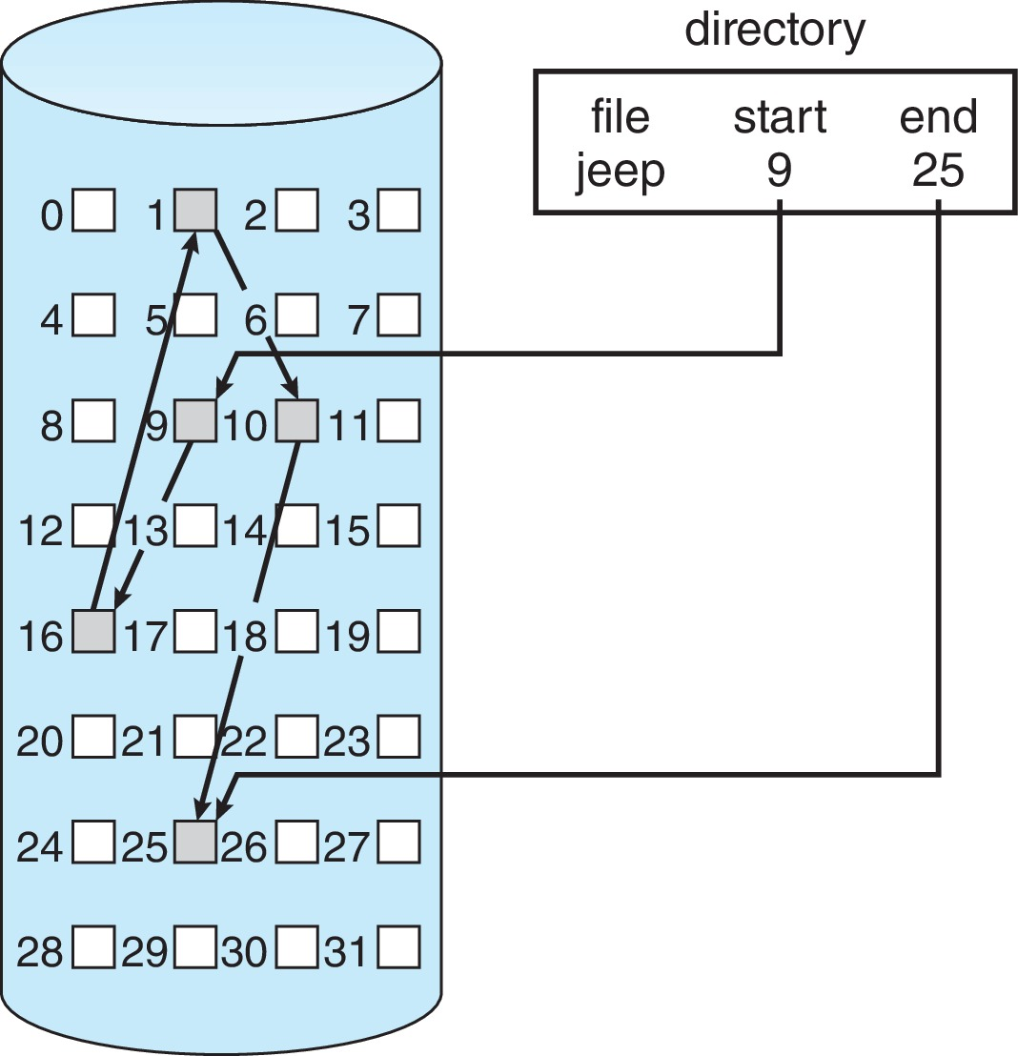
Linked Allocation Example
Each file is a linked list of disk blocks: blocks may be scattered anywhere on the disk
Scheme

Slide 48
Linked Allocation (Cont.)
Mapping
Block to be accessed is the Q^{th} block in the linked chain of blocks representing the file.
Displacement into block = R + 1
Q
LA/511
R

Slide 49
FAT Allocation Method
Beginning of volume has table, indexed by block number
Much like a linked list, but faster on disk and cacheable
New block allocation simple

Slide 50
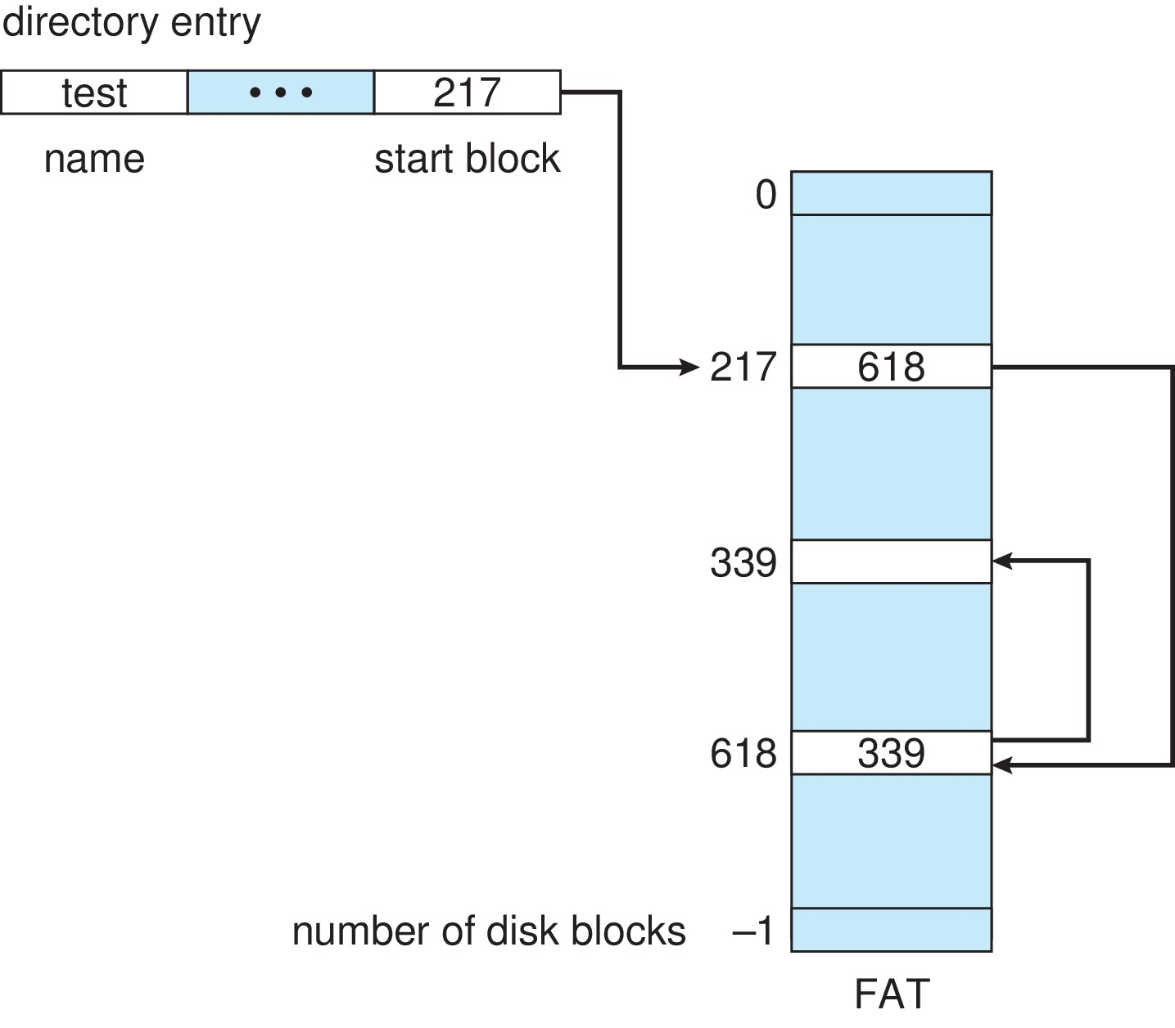
File-Allocation Table

Slide 51
Indexed Allocation Method
Each file has its own index block(s) of pointers to its data blocks
Logical view

Slide 52
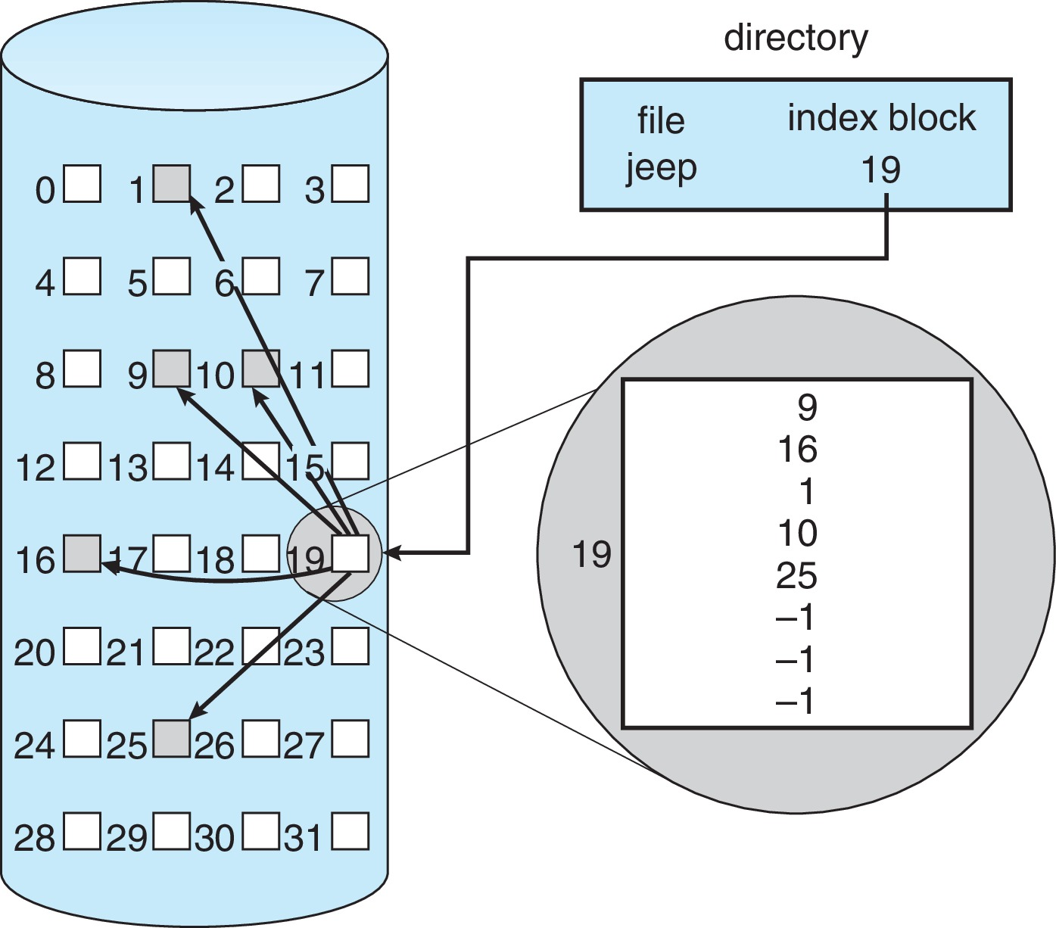
Example of Indexed Allocation

Slide 53
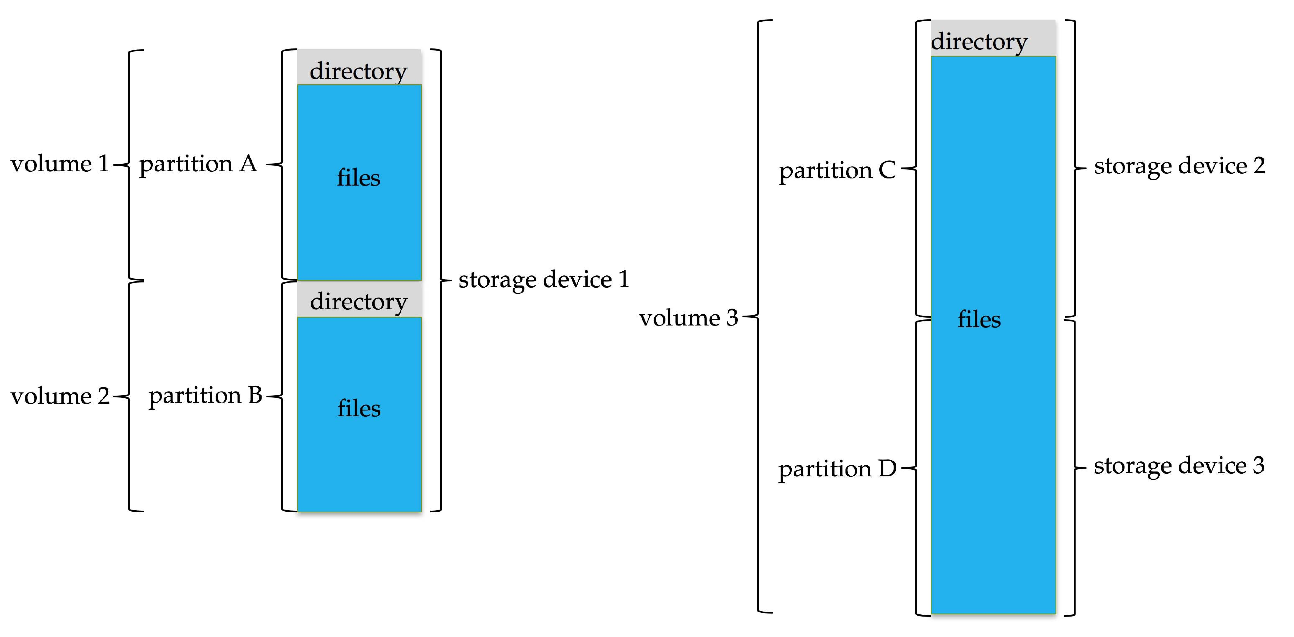
File System (Self Study)
General-purpose computers can have multiple storage devices
Devices can be sliced into partitions, which hold volumes
Volumes can span multiple partitions
Each volume usually formatted into a file system
# of file systems varies, typically dozens available to choose from
Typical storage device organization:

Slide 54
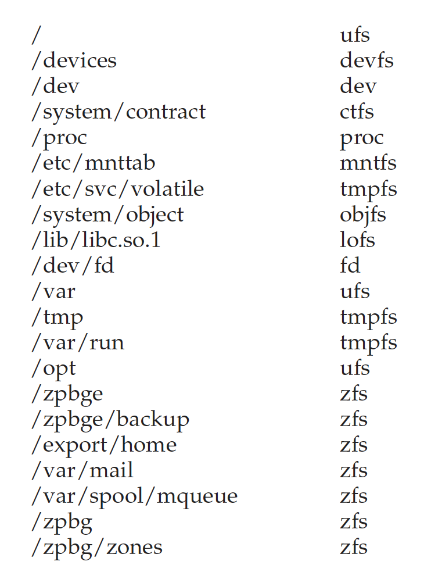
Solaris File Systems (Self Study)

Slide 55
File Sharing
Allows multiple users / systems access to the same files
Permissions / protection must be implemented and accurate
Most systems provide concepts of owner, group member
Must have a way to apply these between systems

Slide 56
Virtual File Systems (Self Study)
Virtual File Systems (VFS) on Unix provide an object-oriented way of implementing file systems
VFS allows the same system call interface (the API) to be used for different types of file systems
Separates file-system generic operations from implementation details
Implementation can be one of many file systems types, or network file system
Implements vnodes which hold inodes or network file details
Then dispatches operation to appropriate file system implementation routines

Slide 57
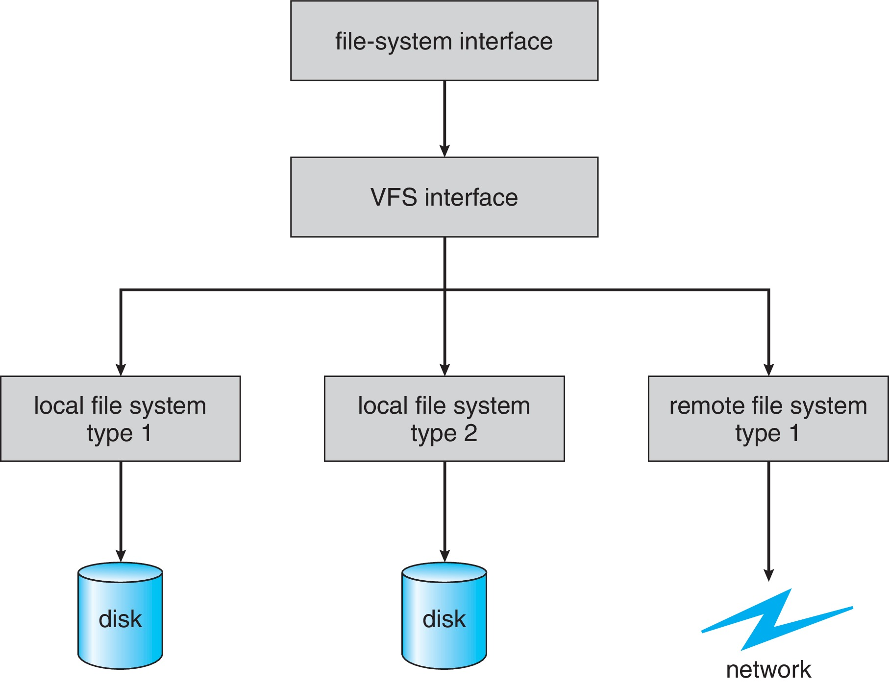
Virtual File Systems (Cont.) (Self Study)
The API is to the VFS interface, rather than any specific type of file system
Example

Slide 58
Virtual File System Implementation (Self Study)
For example, Linux has four object types:
inode, file, superblock, dentry
VFS defines set of operations on the objects that must be implemented
Every object has a pointer to a function table
Function table has addresses of routines to implement that function on that object
For example:
• int open(. . .)—Open a file
• int close(. . .)—Close an already-open file
• ssize t read(. . .)—Read from a file
• ssize t write(. . .)—Write to a file
• int mmap(. . .)—Memory-map a file

Slide 59
Remote File Systems (Self Study)
Sharing of files across a network
First method involved manually sharing each file – programs like ftp
Second method uses a distributed file system (DFS)
Remote directories visible from local machine
Third method – World Wide Web
A bit of a revision to first method
Use browser to locate file/files and download /upload
Anonymous access doesn’t require authentication

Slide 60
The Sun Network File System (NFS) (Self Study)
An implementation and a specification of a software system for accessing remote files across LANs (or WANs)
The implementation originally part of SunOS operating system, now industry standard / very common
Can use unreliable datagram protocol (UDP/IP) or TCP/IP, over Ethernet or other networks

Slide 61
Chapter 6 (Cont’d): OS Security

Slide 62
The Security Problem
System secure if resources used and accessed as intended under all circumstances
Unachievable
Intruders (crackers) attempt to breach security
Threat is potential security violation
Attack is attempt to breach security
Attack can be accidental or malicious
Easier to protect against accidental than malicious misuse

Slide 63
Security Violation Categories
Breach of confidentiality
Unauthorized reading of data
Breach of integrity
Unauthorized modification of data
Breach of availability
Unauthorized destruction of data
Theft of service
Unauthorized use of resources
Denial of service (DOS)
Prevention of legitimate use

Slide 64
Security Violation Methods
Masquerading (breach authentication)
Pretending to be an authorized user to escalate privileges
Replay attack
As is or with message modification
Man-in-the-middle attack
Intruder sits in data flow, masquerading as sender to receiver and vice versa
Session hijacking
Intercept an already-established session to bypass authentication
Privilege escalation
Common attack type with access beyond what a user or resource is supposed to have

Slide 65
Security Measure Levels
Impossible to have absolute security, but make cost to perpetrator sufficiently high to deter most intruders
Security must occur at four levels to be effective:
Physical
Data centers, servers, connected terminals
Application
Benign or malicious apps can cause security problems
Operating System
Protection mechanisms, debugging
Network
Intercepted communications, interruption, DOS
Security is as weak as the weakest link in the chain
Humans a risk too via phishing and social-engineering attacks
But can too much security be a problem?

Slide 66
Program Threats (Self Study)
Many variations, many names
Trojan Horse
Code segment that misuses its environment
Exploits mechanisms for allowing programs written by users to be executed by other users
Spyware, pop-up browser windows, covert channels
Up to 80% of spam delivered by spyware-infected systems
Trap Door
Specific user identifier or password that circumvents normal security procedures
Could be included in a compiler
How to detect them?

Slide 67
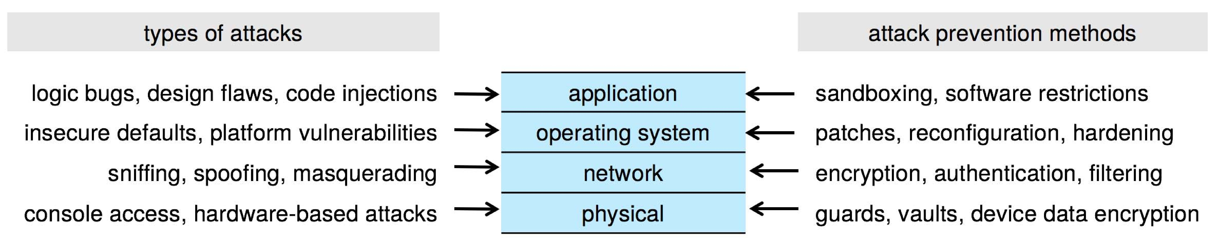
Four-layered Model of Security (Self Study)

Slide 68
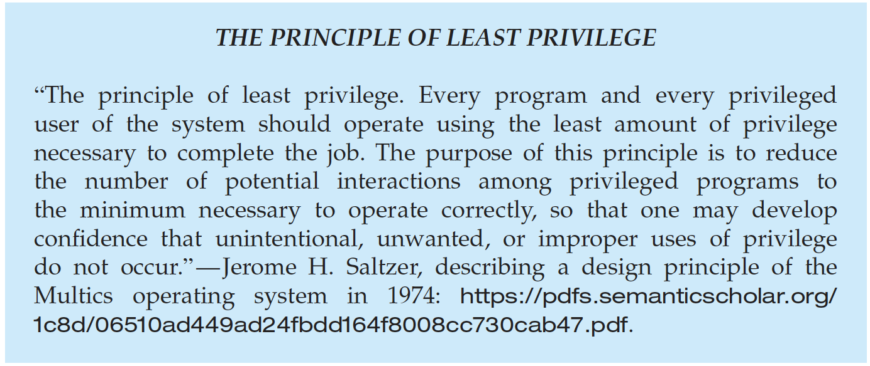
Program Threats (Cont.) (Self Study)
Malware - Software designed to exploit, disable, or damage computer
Trojan Horse – Program that acts in a clandestine manner
Spyware – Program frequently installed with legitimate software to display adds, capture user data
Ransomware – locks up data via encryption, demanding payment to unlock it
Others include trap doors, logic boms
All try to violate the Principle of Least Privilege
Goal frequently is to leave behind Remote Access Tool (RAT) for repeated access

Slide 69
End of Chapter 6

